Slide 1
Cancer Quality of Life Survey
#CancerQualityOfLife
#LivingWithAndBeyondCancer
#PersonalisedCare
Notes:
This slideset is designed to support Cancer Alliances to raise awareness of the Cancer Quality of Life Survey.
NB The slides can be adapted for your local situation.
What can you do to help?
Use this training slideset in presentations at different team, MDT, fora and events to reach as many NHS staff as possible.
Print, display and use the materials described (slide 19) to help raise awareness of Cancer Quality of Life Survey in patients and staff.
Use the range of digital and social resources on your social media and communication channels; re-share social media posts
Put the briefing papers/key messages on your intranet / website and in any newsletters
Talk about the Cancer Quality of Life Survey with friends, family and colleagues

Slide 2
Cancer Quality of Life Survey
The LTP Ambition
‘From 2019, we will begin to introduce an innovative quality of life metric…to track and respond to the long-term impact of cancer.’
Launched 7 September 2020
Notes:
The mandate for the Survey in the LTP p 61.
NB was previously also in the National Cancer Taskforce Strategy.

Slide 3
Cancer Quality of Life Survey
Importance of quality of life outcomes
Empower patients
Guide the national cancer programme – priority setting, managing the impact of cancer
Prompt improvement discussions at a Cancer Alliance, commissioner and provider level
Notes:
Quality of life outcomes are important to patients living with and beyond cancer.
Measuring people’s quality of life is about understanding the impact of cancer and its treatment and how well people are living after treatment.
The Cancer Quality of Life Survey aims to measure quality of life at scale, with comprehensive coverage for all cancer patients
The NHS is committed to raising the profile of quality of life outcomes so that they are ‘equitable’ with survival.
Although patient reported outcome measures (PROMS) that focus on QoL are in use in parts of the NHS, in clinical trials, and in other countries, the potential for PROMS to improve care and outcomes has not yet been fully realised. Only by monitoring QoL with a consistent assessment point with full, nationwide coverage can the data be used to inform the provision of care. For the first time, our survey will routinely measure QoL outcomes at a whole-system level and in a way that influences health policy, professional practice and patient empowerment.

Slide 4
Patient’s View
“I want to celebrate that the NHS is measuring quality of life for cancer patients at a scale and depth not being matched anywhere else in the world.
This powerful and informative data will help shape future services, but more importantly it empowers us to have meaningful discussions about our cancer journey.”
Juliette Chan– Patient and Public Voice Representative – Cancer Quality of Life Survey Steering Group
Notes:
The Cancer Quality of Life Survey has been developed with and for patients.
Patient and public voice representatives are continually contributing their views.
This is a statement from one our patient representatives. Juliette is a member of the NHS England Cancer QoL Survey Steering Group.

Slide 5
Patient’s view – why does this matter?
Impact of my cancer
Understand who I am
Quality of my survival
Design services that support me to live well
Notes:
Patients tells us that they want us to understand:
“That the impact on you of your cancer needs to be looked in the widest possible sense.”
“Quality of survival is as important as survival itself”
The Cancer Quality of Life Survey can help us to understand the impact of cancer and its treatment
The NHS should design services that support you and me to live well with and beyond our cancer

Slide 6
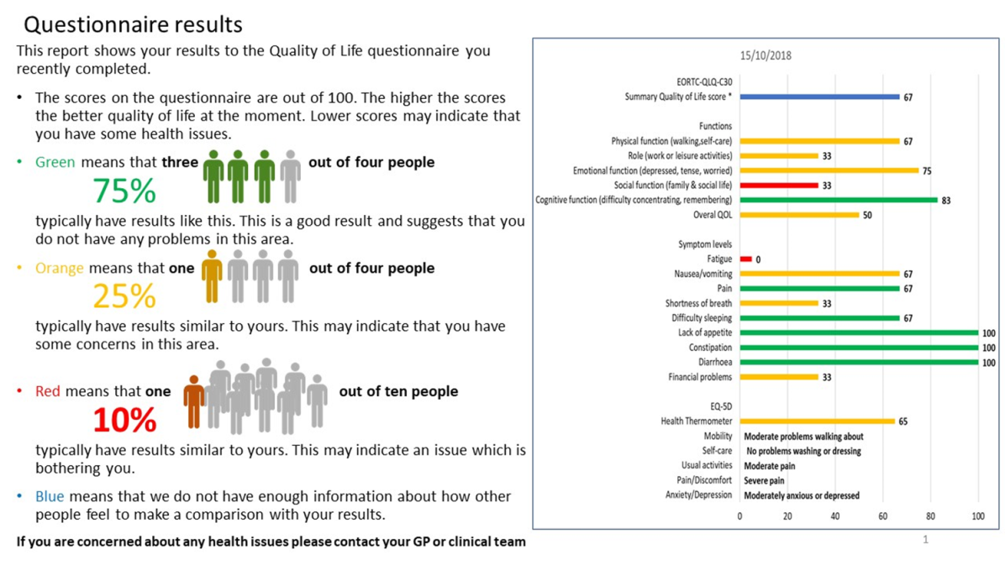
Patients view – but it’s also about empowerment
Empower patients to seek solutions
Use Patient Summaries – personal data
Discuss results with professionals – its about you and what you need
Meaningful engagement so professionals can understand your cancer journey
Empowers you to understand and participate in your care more proactively
Notes:
The main goal of the Survey is to produce results that can be used to inform national and regional considerations of QoL outcomes – using the data to identify areas of best practise or poor outliers, as a starting point for understanding why variation occurs – and then leading to change in provision of services.
However, our PPV partners have also emphasised the need for the Cancer QoL Survey to:
Empower patients to seek solutions to ongoing issues.
The Cancer Quality of Life Survey has therefore also been developing individual patient summaries, based on the answers people give to the Survey. Patients have told us this is a high priority for them.
“The QoL Patients summaries give you your personal data that empowers you to engage in discussions with professionals about you and what you need.
It enables meaningful engagement so professionals can understand your cancer journey; It empowers you to understand and participate in your care more proactively.”
An example of the patient summary – currently ‘in development’ – is shown later in this slide deck.

Slide 7
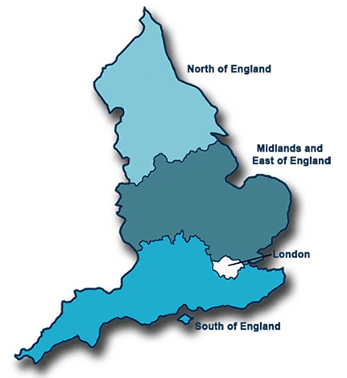
The Pilot Experience
The QoL pilot project aims to evaluate data collection methods and gather data to develop summary QoL metric(s).
Alliance | Trusts
Northern | Northumbria Healthcare NHS Foundation Trust
 | Newcastle upon Tyne Hospitals NHS Foundation Trust
East of England | East Suffolk and North Essex NHS Foundation Trust (Ipswich and Colchester Hospitals)
North Central and East London | University College London Hospitals NHS Foundation Trust
 | Bart's Health NHS Trust
 | Royal Free London NHS Foundation Trust
Wessex | University Hospital Southampton NHS Foundation Trust
Notes:
The design and delivery of the Cancer Quality of Life Survey has been piloted tested in collaboration with four Cancer Alliances in England working in eight hospital trusts.

Slide 8
Initial Pilot Findings
Late stage (4) patients have a poorer QoL than those diagnosed earlier.
Women generally report worse outcomes than men.
>85 years had worse QoL outcomes, but younger people reported more mobility concerns.
Breast patients reported poorer outcomes than prostate or colorectal.
People in deprived areas have a worse QoL.
The general, non-cancer population have a better QoL.
Those with Ca report more issues with anxiety & ADL’s/family/work roles
Notes:
The pilot project tested a range of survey options.
The outcomes of these tests shaped the final design and roll out of the Survey.

Slide 9
Initial Pilot Indications
Improve psychosocial care for cancer patients to alleviate anxiety;
Improve physical functioning and mobility, and reduce fatigue, through the provision of rehabilitation or ‘pre-habilitation’ services;
Target resources at deprived areas.

Slide 10
Nationwide data collection criteria
Item | Phase 5 – 20/21 | Phase 6 – 21/22
Cancers | Breast, prostate and colorectal | All
Invites | 71,175 | 237,000 rising to 249,500
Instruments | EORTC QLQ C-30 ; EQ-5D 5L | EORTC QLQ C-30 ; EQ-5D 5L
Coverage | Census | Census
Age | Adults only (>16 years) | Adults only (>16 years)
Timing | 18 months post-diagnosis | 18 months post-diagnosis
Assessment | Single survey point | Single survey point
Mode of completion | Initial ‘electronic’ invite followed by a ‘paper’ reminder | Initial ‘electronic’ invite followed by a ‘paper’ reminder
Patient reminders | Two weeks after initial invite | Two weeks after initial invite
Geographic coverage | All England | All England
Patient feedback | Development and testing | Fully implemented patient summary
Equality of access | Provide telephone/online support; translated and easy read information | Provide telephone/online support; translated and easy read information
Notes:
This slide shows what will be implemented this year (2020/21) AND what is planned for the following year.
2020/21: Breast, prostate and colorectal patients only, 18-months post-diagnosis. Invites are sent to newly eligible patients every month.
20221/22: The aim is to include ALL patients, ALL of the time, ALL of England
NB Also to note – patient summaries to be introduced next year (2021/22).
We anticipate growing and expanding the programme of work year on year.

Slide 11
Centralised system
KEY
Year 1
Year 1 dashed (non-response)
Year 2
Data boundary sharing
PHE
(data controller)
Eligible patients identified
Data stored in Cancer Registry
Patient list sending to Supplier
Data boundary
1
2
Data sending to PHE
Quality Health
(data processor)
Patient responses received
Data cleaning and quality assurance
Patients sent letter with electronic survey invite
Patient list checked
Produce patient summaries
Reminders (paper survey) sent
Data inputting
Data boundary
3
Patients
Summary report received by
Patient
Notes:
This slide shows how the Survey is managed.
Trusts will not need to identify patients
Quality Health has been commissioned to manage the survey invites and responses
PHE are identifying eligible patients using data from the Cancer Registry
Quality Health return survey responses to PHE – the data becomes part of the Cancer registry
Importantly answers to the survey are submitted to the Cancer Registry at PHE (NCRAS). This means that each person’s survey responses has been linked to data on what happened to them in terms of e.g. cancer type, stage of disease, treatments completed, treating trusts etc.

Slide 12
Cancer QoL Survey Launch
September 2020
10% sample
December 2020
100% census
Nationwide test
Breast, prostate, colorectal
Full nationwide coverage
Breast, prostate, colorectal
Notes:
The Survey will launch in September.
In September a random 10% sample of breast, prostate and colorectal cancer patients will receive a survey from a company called Quality Health who are acting on behalf of NHSE and PHE to manage the survey fieldwork.
Following a 3-month test period, ALL breast, prostate and colorectal cancer patients will be invited at 18-months post-diagnosis to complete the Survey.

Slide 13
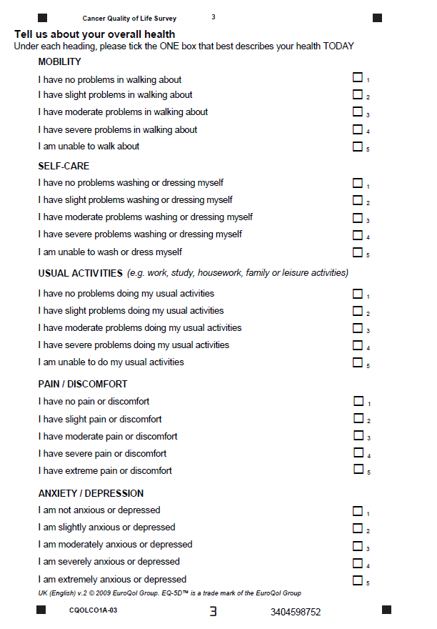
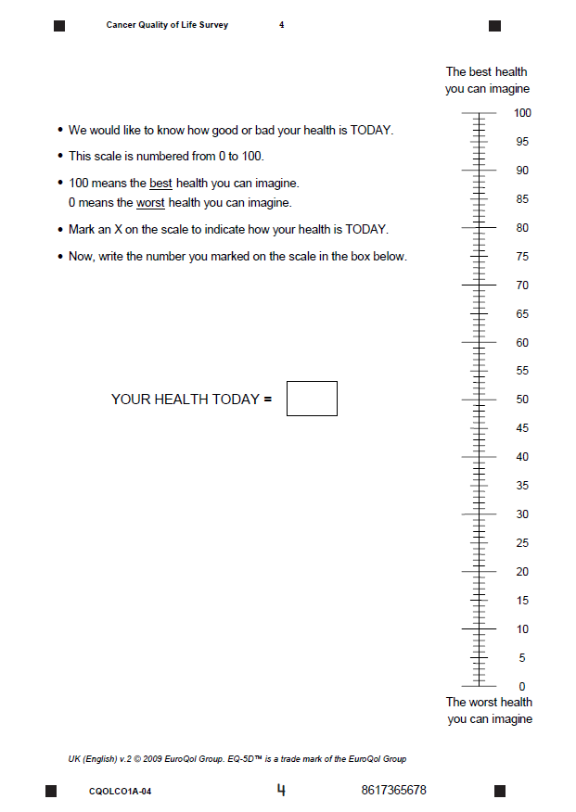
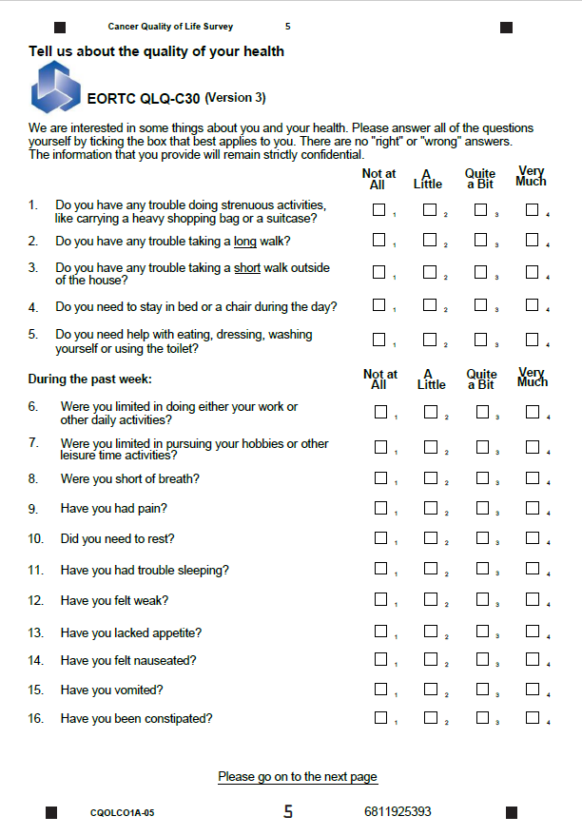
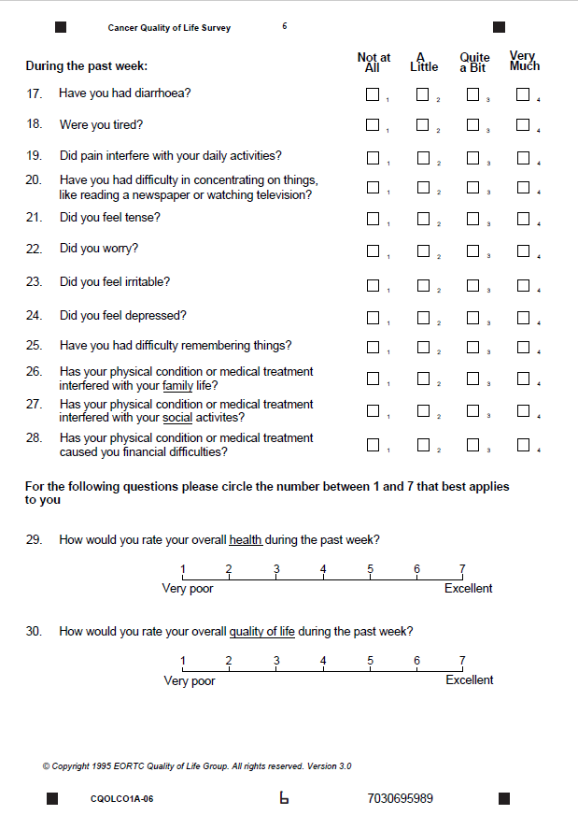
QoL Questionnaires
EQ-5D 5L (QoL measures)
Summary scores include Utility/Profile, QALY, 1-100 VAS
EORTC QLQ-C30 (30 items)
Summary scores include summary domains and the overall score
Both electronic and paper questionnaires
are in use
Notes:
The Survey is comprised of two, validated and well-used questionnaires – EQ5D and EORTC QLQ C30.
EQ-5D is a generic, 5-item questionnaire – widely used to measure QoL outcomes, it can be used for any illness, and produces ‘utility’ scores that inform cost-benefit analyses (QALYS).
EORTC QLQ C-30 is a cancer-specific questionnaire with 30 items producing summary scores for different outcomes e.g. phsycial, social or emotional

Slide 14
Metric – Summary scores
EORTC QLQ-C30
EORTC Summary: A summary score of health-related QoL; subset of the EORTC QLQ C30 items.
EuroQol EQ-5D 5L
EQ-5D Utility: A utility score to measure of health-related QoL weighted by societal ratings of the ‘health state’ of patients’; commonly used in cost effectiveness analyses
EORTC domains and symptom scales: physical, role, cognitive, emotional, social, fatigue, pain, nausea and vomiting
EORTC single-item overall health and/or overall quality of life – 2 items can be combined to form a Health-related quality of life score
EQ-5D VAS: Visual analogue scale score (VAS); measures self-reported health ‘today’ on a 0-100 scale.
EQ-5D dimensions: Scores by ‘domain’ or single items as follows mobility, self-care, usual activities, pain/discomfort, anxiety/depression
Notes:
This slide shows some of the summary scores that can be produced using the two questionnaires.

Slide 15
Metric Reporting Options
Level 1
National reporting
Level 2
Regional and Alliance reporting
Pre-defined cut off scores, RAG rating; use case mix adjustment e.g. Cancer Stats 2
Level 3
Patient summaries reporting
Visualisations of summary QoL scores seen by patients
Focus LWBC work on managing the impact of cancer
Engage stakeholders and encourage commissioning of work on QoL improvement.
Identify good practise or areas for concern
Inform service improvement or sharing of best practise for QoL
Prompt supportive care planning conversations in primary and secondary care.
Differences between groups e.g. by cancer type, treatment type, stage of disease, co-morbidity, deprivation, gender, ethnicity etc.
Notes:
We propose to report the data at a range of levels
National reports – published through the ‘Cancer Data’ website by PHE; this is fully public facing
Regional /Alliance reports will be published through ‘Cancer Stats 2’ by PHE, with support from CADEAS; these will be ‘internal’ only publications.
Individual summary – this is shown in the next slide

Slide 16
Patient summary – 2021 onwards
Notes:
During the pilot, we tested giving each patient feedback on the outcome of their survey. We tested a range of formats with patients and clinicians – resulting in the prototype shown above.
The summaries will not routinely be included when the survey is first rolled out, but should start to be in use from 2021 onwards.

Slide 17
Working with your Cancer Alliance
LWBC Alliance Leads will be working to support delivery of the Cancer QoL Survey
June 2020 (Year 1): Communicating and engaging
- Deliver awareness raising activity.
- Local point of contact for information and advice on survey roll out.
- Support for escalating questions to the national team.
June 2021 (Year 2 onwards): Using data and reports
- Feeding back results of the survey.
- Identifying opportunities to start local quality improvement projects.
- Sharing best practise across the area.
Notes:
Alliances will be supporting the roll out.
Alliances will be raising awareness locally to support uptake of the survey.
Alliances are the point of contact for any arising issues – they can escalate to the NHSE central team, as necessary.
Alliances can deliver training and education locally to discuss the launch of the Survey.

Slide 18
What you can do to help
Cancer Quality of Life Survey
Promote uptake of the survey in patients
Promote awareness of the survey in trusts and primary care
Engagement with the current approach to QoL locally; assess ‘readiness to change’
Support patients and respond to queries
Notes:
It is vitally important that we encourage patients to take part.
The more people take part, the more representative and valid the results will be.
All parts of the NHS need to become aware of the Survey – patients could easily ask you if you know about this survey.
What can you do to help?
Use this training slideset in presentations at different team, MDT, fora and events to reach as many NHS staff as possible.
Print, display and use the materials described (slide 19) to help raise awareness of Cancer Quality of Life Survey in patients and staff.
Use the range of digital and social resources on your social media and communication channels
Follow us on Twitter and re-share our social media posts
Put the briefing papers/key messages on your intranet / website and in any newsletters
Talk about the Cancer Quality of Life Survey with friends, family and colleagues

Slide 19
Supporting products
Product | Brief description | Location
Communications toolkit | Visual identity guide Tailored slide set(s) Slide template Briefing notes and key messages Locally printable poster Social media suggestions FAQs Example surveys and letters QoL Case Studies | Cancer Alliance Workspace: https://future.nhs.uk/canc/view?objectID=19564592 Or on request from your Cancer Alliance.
Website and helpline | Information for patients and the public Access to online survey completion Fully searchable and open to all | www.CancerQoL.england.nhs.uk T: 0800 783 1775
Notes:
The NHS England Cancer Programme team have developed a ‘toolkit’ of communication products.
This is available on the ‘Cancer Alliance Workspace’ (Kahootz/ Future NHS platform).
What can you do to help?
Use this training slideset in presentations at different team, MDT, fora and events to reach as many NHS staff as possible.
Print, display and use the materials described (slide 19) to help raise awareness of Cancer Quality of Life Survey in patients and staff.
Use the range of digital and social resources on your social media and communication channels
Follow us on Twitter and re-share our social media posts
Put the briefing papers/key messages on your intranet / website and in any newsletters
Talk about the Cancer Quality of Life Survey with friends, family and colleagues

Slide 20
Who can I contact for more information?
Contact | Details
Alliance team | england.swagca@nhs.net
National Cancer Programme | Alice.simon@nhs.net Erin.barton@nhs.net
Quality Health | Helpline - 0800 783 1775 Email - helpline@quality-health.co.uk
Notes:
Please add in any additional contact details for your Alliance here.

Slide 21
Thank you! This survey is being run jointly by Public Health England and NHS England and NHS Improvement.
#CancerQualityofLife
#LivingWithAndBeyondCancer
#PersonalisedCare

