Slide 1
ICR Update
May 2021

Slide 2
Data Currently Being Shared
Next feeds going live
New Developments at RUH

Slide 3
Data Currently Being Shared to the ICR
BaNES GP Data
Nightly Feed of data recorded locally:
Demographics
Immunisations
Medications
Referrals
Active & Past Problems
Allergies
GP results
GP Encounters
Contraindications
Operations
Radiology
Investigations
Family History
Pregnancy, Birth & Post Natal
Contraception & HRT
RUH
Real Time Feed:
Inpatient Activity (wait list, admissions, transfers)
Outpatient Activity (referral, appointments, attendance)
Clinic Letters and Correspondence
Pathology results,
Radiology reports
Emergency Attendance
Discharge summaries
Flexi cystoscopy & Sigmoidoscopy results*
Colonoscopy Results*
Gastroscopy result*
*More detail on slide 6
Community (BaNES)
Nightly Feed:
Demographics
Immunisations
Diagnosis
Medications
Referrals
MIU Data (Paulton)
BaNES LA
Nightly feed:
Demographics
Referral
Event data including:
Assessments, Safeguarding, DOLS
Care Plans
Service Provisions including non-plan service provisions
Alerts
Disabilities
Practitioner
Classifications i.e. support reason

Slide 4
Planned / Underway
Swindon and Wilts Primary Care:
Nightly feed
RUH Facing Practices May ’21
Remaining Practice* May/June ’21
* Subject to having signed the DSA
Swindon LA
Wilts LA
Nightly feed
May ’22
GWH
Real Time Feed
Phase 1
GWH
Real Time Feed
Phase 2
SFT
Real time feed
Apr 21
May 21
June 21
Jul 21
Aug 21
Sep 21
Oct 21
Nov 21
Dec 21
2022
Medvivo
Nightly feed
AWP
Real time feed
Community: WHC & Swindon
Nightly feed
Phase 1
Community: WHC & Swindon
Nightly feed
Phase 2

Slide 5
Planned / Underway: June - August
Medvivo:
(June ’21)
111, Out of Hours, Urgent Treatment Centre activity.
AWP:
(June ’21)
Real Time Feed:
Demographic information
Allergies
Inpatient stays – Admission, Transfer, Discharge and Leave events
Referrals to community teams
Appointments – Planned and past
Care Coordinator name and contact details
Crisis, Relapse and Contingency Plans
Overnight Transfer:
Perinatal Care plans
Inpatient Discharge Summaries
Note: Only data from the AWP core clinical information system RiO is included in the initial phase.
GWH:
Phase 1 inpatient and outpatient activity, plus alerts
(June ’21)
Phase 2 (following Medway upgrade in July): Pathology and Radiology results and correspondence
Community – WHC & Swindon:
Phase 1 : Referrals & Encounters/Appointments (June ’21)
Phase 2 : TBC, potentially: Vaccinations, Medications, (August ’21)

Slide 6
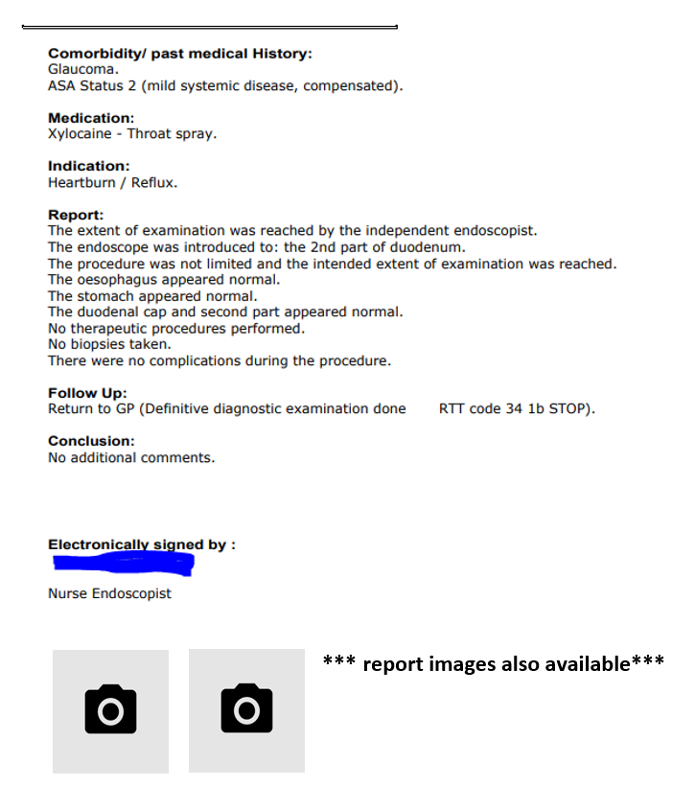
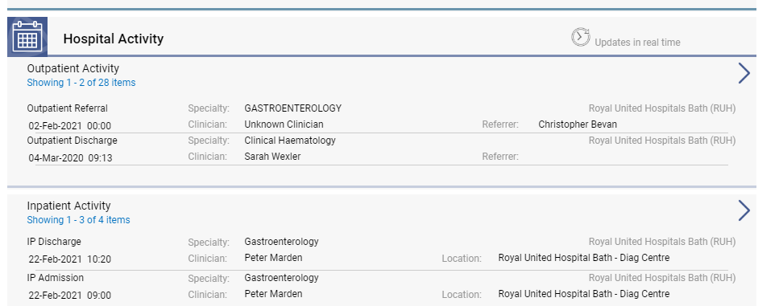
New Developments at RUH - ICR New Documentation
RUH is now sending reports to ICR for:
Flexible cystoscopies
Colonoscopies
Gastroscopies, and
Flexible Sigmoidoscopies
Patient was admitted for Gastroscopy and the report is in the Clinical Letters view.
GPs will be able to see:
- Appointment for tests
- Results
Reports are completed on the day of the test and sent into the ICR in real time into the Clinical Documents tile.
Future Developments: Integrating Cardiology reports

