Slide 1
BSW Hospices Together
BSW ICB Board
16th November 2023
Carolyn Bell, Pippa Baker, Wayne de Leeuw
Notes:
Wayne

Slide 2
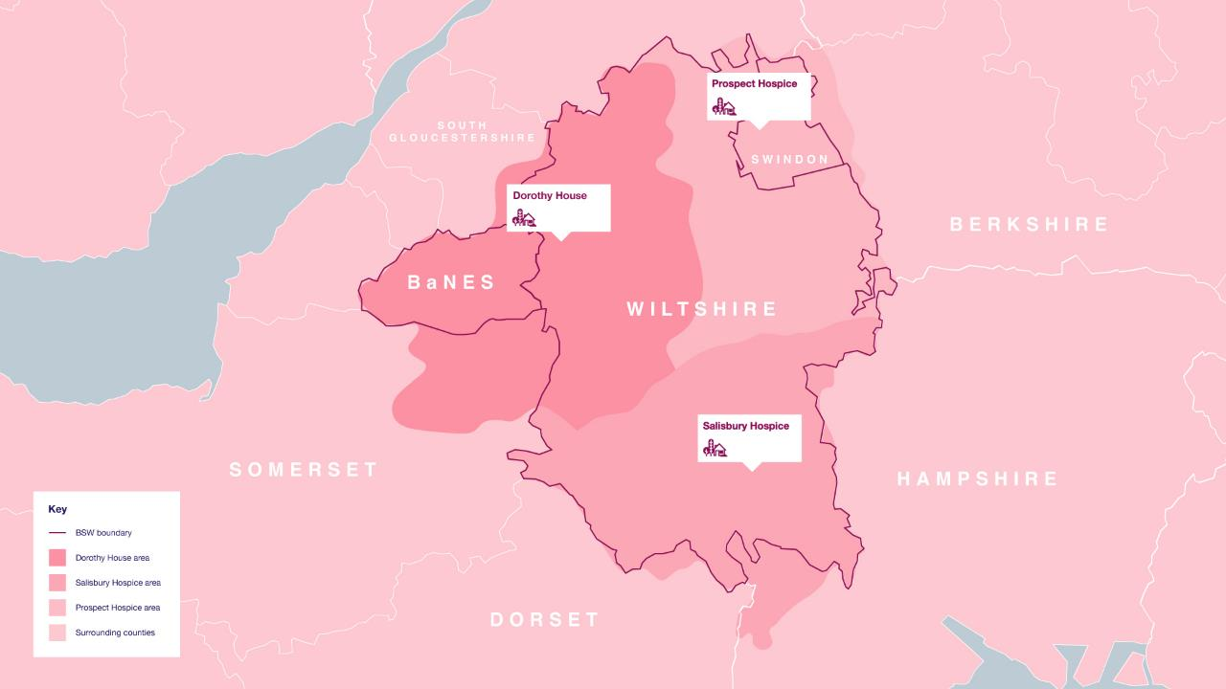
Notes:
Wayne

Slide 3
Specialist palliative & end of life care:
Is care for patients and families, delivered in partnership with health and social care colleagues, provided every day in a range of settings, including in people’s own homes, general practice, nursing and residential homes, acute trusts and across our hospice sites. For people with complex needs as a result of any life limiting illness that is best met by the specialist palliative care MDT.
Workforce of staff and volunteers with specialist skills and experience, including specialist nursing, consultants, and access to MDTs including a range of physical and psychological therapies.
Specialist services offer
In-depth specialist knowledge to undertake assessment and management of physical, psychological and spiritual symptoms to reduce symptoms, suffering and distress
Complex decision making including when medical and personal interests are finely balanced (e.g. quality of life)
Providing specialist advice and support to the wider health and care system.
Enhanced health and wellbeing support to the person and their family.
Notes:
Carolyn

Slide 4
Specialist services in BSW
Dorothy House and Prospect
Salisbury Hospice / SFT
RUH
GWH
predominantly charitably funded, stand-alone hospices with NHS contracts to deliver community and inpatient services.
NHS service with significant charitable funding, fully integrated within the acute trust, providing services across the community, hospice and acute hospital.
nurse led palliative care team with consultant provision from Dorothy House.
consultant led palliative care team and Swindon care at home.
Notes:
Carolyn

Slide 5
BSW specialist palliative and end of life care services provide:
Medical Service across inpatient, acute and community settings
Inpatient Units in each hospice (=26 beds)
24/7 specialist advice line
Community Palliative Care Teams: Locally focussed, multi-disciplinary teams, including community consultants
Hospice at Home (H@H): Specially trained healthcare assistants providing end of life care in the community
Range of therapies: Physiotherapy, Occupational Therapy, Lymphoedema Service, Complementary Therapy, Creative Arts, Dietetics and Nutrition
Family Support Services: Adult social work, children and young people’s service, bereavement services, psychological support, spiritual support, companionship, financial advice
Day Services: Nurse and therapy -led services, clinics and a range of informal wellbeing, relaxation, exercise and social groups
Education, Research & Professional Development
Open Access Community Groups: Bereavement, Walking, Writing, Coffee Connections, Allotments Group, Dementia Cafe, Carers groups
Monitoring of patient outcomes on an individual and service basis.
Between 20 and 30% of our overall expenditure in FY22/23 was funded by NHS contracts; we fundraise, access grants, receive gifts in people’s wills and have significant retail operations.
Means services that
Are personalised to people’s needs and wishes “What matters to you”.
Keep people at home for longer.
Reduce demand for ambulances, ED admissions and LOS in hospitals.
Facilitate rapid discharge for people who are identified in hospital, supporting a reduction in NCtR.
Notes:
Carolyn

Slide 6
Quiz time!
How many people do you think BSW hospices support each year?
1500 4000 6000
What proportion of non-cancer patients do you think we support each year?
10% 30% 40%
Across all three hospices, we support over 6000 people and their families each year.
How many volunteers do you think we have altogether?
1000 1500 1870
Around 30% of patients do not have cancer. Life-limiting illnesses other than cancer include lung disease, heart failure and Motor Neurone Disease
1870 people volunteer their time to work across clinical and non-clinical services.
Notes:
Wayne

Slide 7
The breadth of provision
Working in people’s own homes, CNS / Consultant and wider specialist MDT collaboration and liaison with District Nurses, social care and wider MDTs advice and guidance.
Attending GP MDT / GSF meetings to provide advice and support and identify patients who may need services, including CNS / Consultant specialist advice and early referrals
Patient flow co-ordinator “walks the wards” to pull patients from acute service.
Complex pain and symptom management.
Clinical, medical and (poly)pharmacy advice.
Out patient clinics – nurse and Dr led
Range of MDT roles to support patients and loved ones, including psychotherapy / spiritual care / palliative care social workers / bereavement counsellors.
Specialist roles vary by hospice, including MND lead co-ordinator, heart failure nurse, dementia nurse, respiratory practitioner, volunteer companions.
Access to day hospice support which may include gym and reablement work.
Consultant in reach to the wards in the acute hospitals
Training, education and research and placements in partnership with local Universities
Joint specialty clinics in RUH, Salisbury offers neurology and heart failure clinics / MDTs and cancer site specific MDTs. Prospect Respiratory practitioner attends neurology clinic.
Additional services like blood transfusion, ascitic drains
Compassionate companions
Digital collaboration incl using of VR, all working towards use of single patient record system (S1)
Notes:
Wayne

Slide 8
Complexity in the Inpatient Unit
A patient with a brain tumour, admitted from home for psychological support, symptom control, and acute respite, became acutely psychotic over a weekend.
As the patient had not had the mental capacity to consent to admission, a DOLS was already in place.
The police were called once to assist in managing his behaviour and restrain him prior to sedation, and another time to bring him back to the IPU from where he had absconded.
His psychosis was managed on the IPU by providing sedation, following input from psychiatry colleagues.
The working diagnosis was steroid induced psychosis.
His sedation was weaned and it became clear he had deteriorated neurologically - likely due either to an intracerebral haemorrhage or due to rebound cerebral oedema. This was deemed to be irreversible.
Support to children and partner to support understanding and decision making.
In keeping with the wishes of the patient (prior to his deterioration) and with those of his family, he remained at the hospice for end of life care.
Notes:
Wayne

Slide 9
What matters to me: Sam
Sam was a 57 year old man with a diagnosis of Motor Neurone Disease (MND).
He lived with his wife Gill and a teenage daughter, who had additional needs, he had a son at university and an older daughter who lived locally.
Maintaining control and independence with his work and home life. Sam was a project manager, skilled with IT- methodical, liked ALL relevant information before decision making could occur.
Sam would always prioritise work over healthcare intervention, initially reluctant to accept advanced planning.
Sam did not want to medicalise his home/ disease progression.
Personal preference for Gill to support him with all his care needs and activities of daily living – she wanted to be able to do this for him.
Sam’s goals:
To stay sleeping in his own bed with his wife for as long as possible.
To attend his daughter’s wedding.
To work for as long as he possibly could.
Themes:
Positive risk taking: personalised risk assessments for moving and handling to enable single handed care and meet Sam’s goals as well as facilitate him staying at home, aligned to his wishes.
Ongoing personalised care maintaining what mattered to Sam at the heart of the interventions.
Open and honest conversations: advance care planning/ReSPECT/ equipment provision and changing needs.
Case management led by hospice therapy and liaison with multiple partner agencies.
Sam successfully went to his daughter’s wedding and stayed in a local hotel. He was working up until when he died.
Notes:
Carolyn – swap Dhse first

Slide 10
Equitable access to hospice care - supporting homeless people The average age of death for homeless women is 42 & for homeless men it is 46 in England and Wales
People experiencing homelessness have more health problems & die a lot younger than the general population.
Key issues:
Barriers in access to healthcare services.
Fear of being treated badly, stigma.
History of trauma.
‘Undeserving’ – struggle with formal hospice or care home setting.
Conflict between the recovery-focused nature of many services and the realities of health and illness for homeless people result in a lack of person-centred care for those with advanced ill health.
Applied learning from other hospices.
Palliative Care social worker and ANP trainee and community consultant working together with other agencies & leading role in co-ordination and case reviews.
Examples of working effectively with refugees, ex offenders who are homeless – often with drug & alcohol related needs, breadth of complex needs and element of unpredictable situations. Hospice catering services have provided initial support with food provision.
Developing trusting therapeutic relationships is key – often lacking in their lives before.
Feedback “ I couldn’t have got here without you” “ no one’s been bothered with me before” “ the beginning of my life was rubbish - the ending will be good now,” “ this is the real deal now – I can make you a coffee!”
Notes:
Carolyn

Slide 11
Integrated working with SFT
50 year old lady with metastatic cancer, a single mother and still working. Receiving palliative chemotherapy under the care of Southampton (UHS).
Community Palliative Care input:
Symptom control of pain
Co-ordinating care for patient with oncology, psychology (severe anxiety) and primary care (attending GSF meetings)
Support for family – children and parents
Future care planning
ED attendance, Nov ‘23, early hours.
Palliative Medicine Consultant and CNS review to advise re: symptom management of pain and nausea, provide reassurance and onward referral to psychology, offering early community support (CPCT) to facilitate discharge from ED rather than acute medical admission and investigations (CT).
Follow up support:
CPCT phone call and visit next day. Patient at home with improved symptoms and support for family.
Oncology team aware and early review re treatment.
Psychology re-referral and seen within the week.
Reflections:
Could 24/7 helpline have prevented ED attendance (consider panic/anxiety of patient/family)?
Palliative care often involved whilst treatment continues.
Real time reporting in Salisbury to intervene early.
Fully integrated service on acute hospital site - seamless support. Close working between community and hospital teams is key for patients but also improves efficiency.
Notes:
Pippa

Slide 12
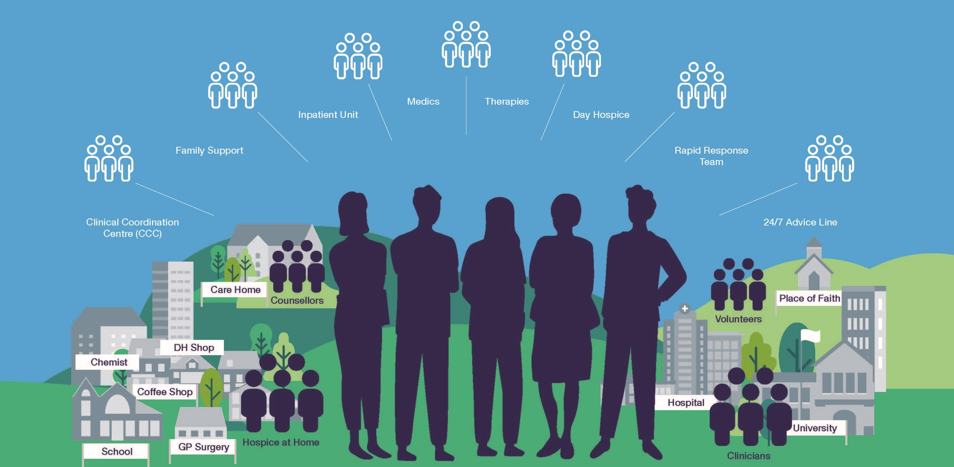
Our neighbourhood
Education and research
Notes:
Wayne

Slide 13
BSW Hospices Together
We’ve historically worked alongside each other in our own patches.
Co-chairs of the BSW PEOLC Alliance, taking opportunities to work together.
Over the last year, working more directly with each other: building stronger relationships, proactively working together wherever possible in strategic decision making and to support neighbourhood delivery.
Alignment of our referral criteria and processes.
Better collaboration on our bed base and understanding of the specialist bed requirements for the future.
Scoping joint working on our advice lines, and how this fits with the BSW care co-ordination centre / any future “gold line” model.
Development of alignment in reporting.
Collaboration between quality teams and research opportunities.
Two of our hospices are working on the St Christopher’s Advancing nursing practice course, both also implementing Lantern model (contemporary model of nursing for people at EOL)
Commitment to regular strategic conversations, as well as weekly operational calls.
Notes:
Wayne

Slide 14
Reducing variation
The system isn’t perfect, we can all improve by:
Reducing duplication between services which is also frustrating for patients and families who have a trail of people coming through their homes.
Work with and through each other even better to provide advice, including using technologies to support assessment.
Reducing inequity in access to services based on historical commissioning and provision, cancer/non-cancer, institutional and societal norms about death and dying, many of which can be intersectional.
Develop stronger outcome measures together to facilitate inter-service benchmarking and improvement.
We offer services tailored to particular groups of people to support a reduction in unwarranted variation, for example
Dementia UK Admiral Nurse,
Supporting family members who have LD, including in schools and with LD teams to support fair access to services
Support to armed forces populations
Homelessness projects to improve access and outcomes, including supporting discharge planning and care on discharge.
Frailty project funded by HUK,
Ensuring service delivery to rural populations, e.g. new provision in Chew Valley
Personalised care supports better meeting the needs of people with protected and other characteristics, e.g. deprivation.
Notes:
Wayne

Slide 15
BSW Palliative and End of Life Care Alliance
Each person is seen has an individual I, and the people important to me, have opportunities to have honest, informed and timely conversations and to know that I might die soon. I am asked what matters most to me. Those who care for me know that and work with me to do what’s possible.
Each person gets fair access to care I live in a society where I get good end of life care regardless of who I am, where I live or the circumstances of my life.
Maximising comfort and wellbeing My care is regularly reviewed and every effort is made for me to have the support, care and treatment that might be needed to help me to be as comfortable and as free from distress as possible.
Care is coordinated I get the right help at the right time from the right people. I have a team around me who know my needs and my plans and work together to help me achieve them. I can always reach someone who will listen and respond at any time of the day or night.
All staff are prepared to care Wherever I am, health and care staff bring empathy, skills and expertise and give me competent, confident and compassionate care.
Each community is prepared to help I live in a community where everybody recognizes that we all have a role to play in supporting each other in times of crisis and loss. People are ready, willing and confident to have conversations about living and dying well and to support each other in emotional and practical ways.
The BSW PEOLC Alliance is formed of all providers and commissioners of PEOLC across BSW.
Chaired by hospice CEO
Championed by BSW ICB Chief Nurse.
The work programme is aligned to the national ambitions for PEOLC and local strategy and will now align to the needs of the ICBC.
Notes:
Wayne

