Slide 1


BSW Integrated Care Record
New Look ICR Before and After

Slide 2
ICR: New Look Changes Benefits
A new Summary Page now displays more useful information upfront to support quicker understanding and decision-making
Improved use of screen space: The new look makes better use of the available screen area, allowing more information to be displayed at once and reducing the need for scrolling.
Consistent data presentation: Information is displayed in a clearer and more consistent way, making it easier to read, scan quickly, and review in detail
Tabbed navigation: Information is grouped into tabs by category, making it easier to find specific details and reducing information overload.
Hero items on Summary Pages: Important information is highlighted at the top of Summary Pages so users can quickly see key details and understand the information that follows.

Slide 3
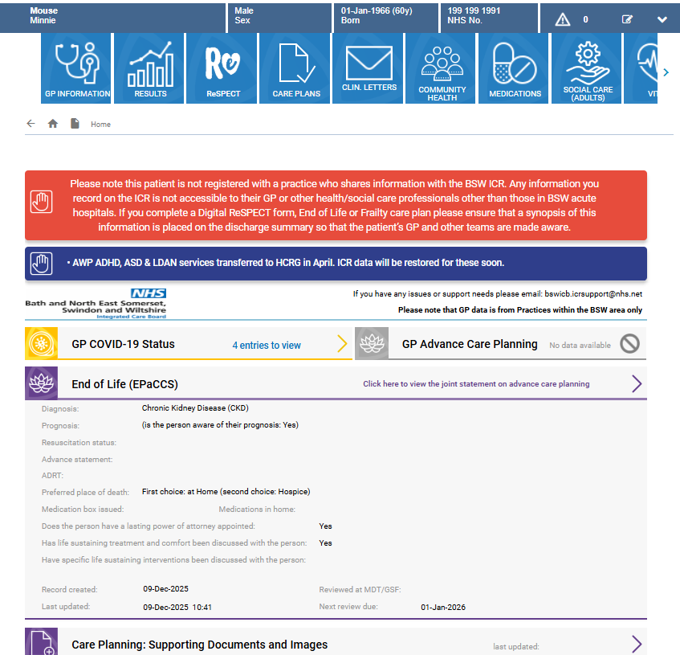
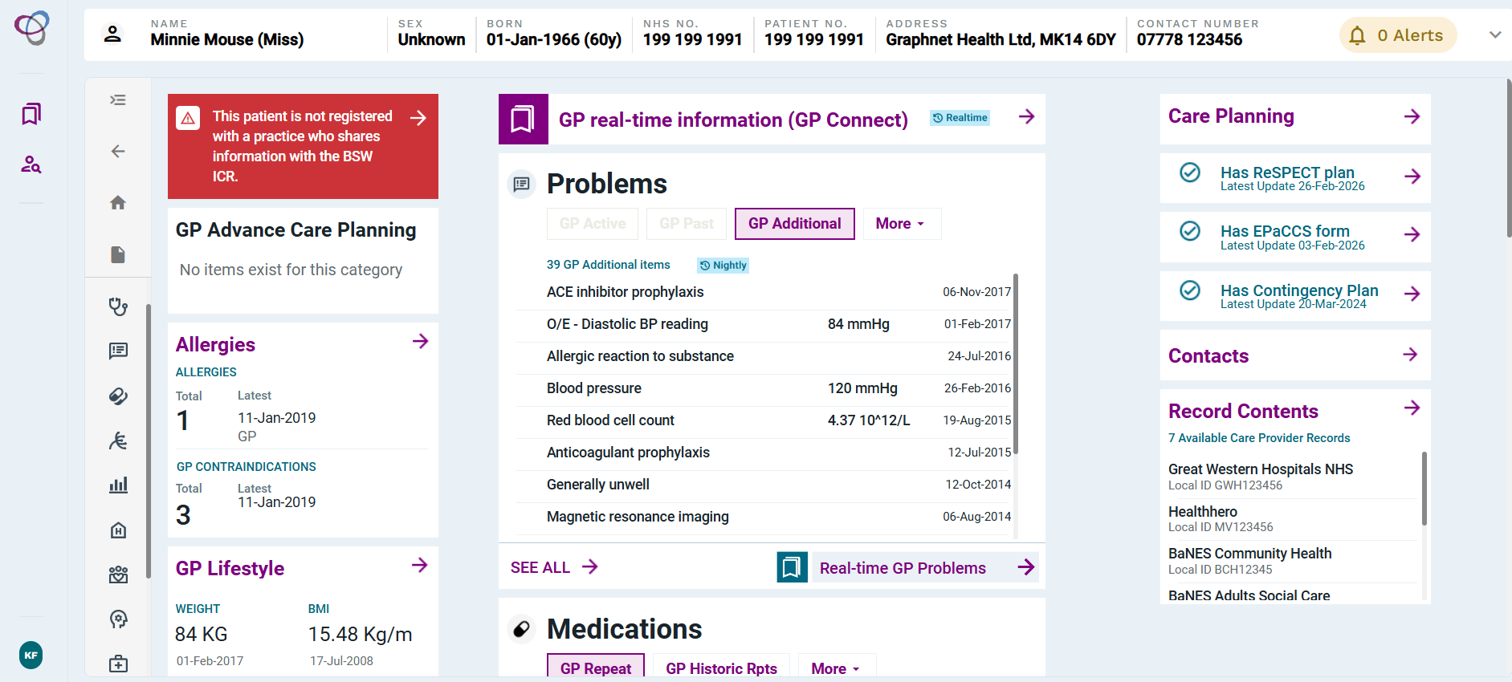
ICR New Look
The ICR is changing and will feature a redesigned summary page and a more user-friendly interface. While the ICR will continue to provide the same valuable patient data, some information may be located in different sections of the system.
Old ICR Landing Page
New Look ICR Landing Page
The new Summary Page provides key information at a glance, allowing you to quickly find what you need without having to navigate to other sections.

Slide 4
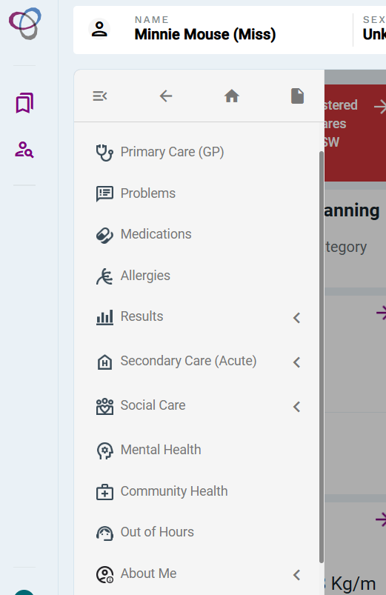
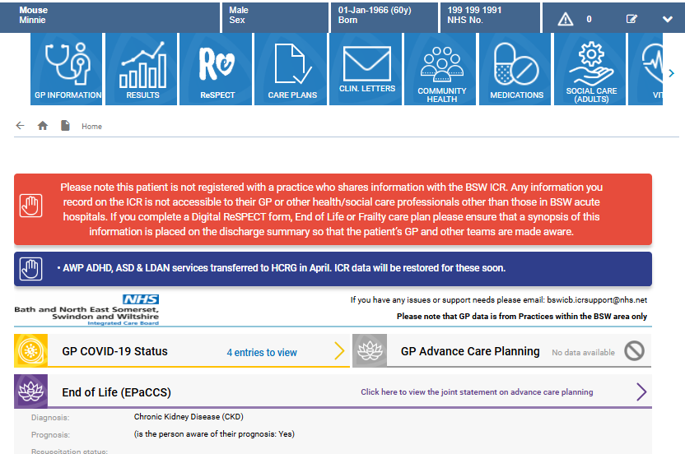
Navigation Bar
New Look ICR Navigation Menu
Old ICR Navigation Tiles

Slide 5
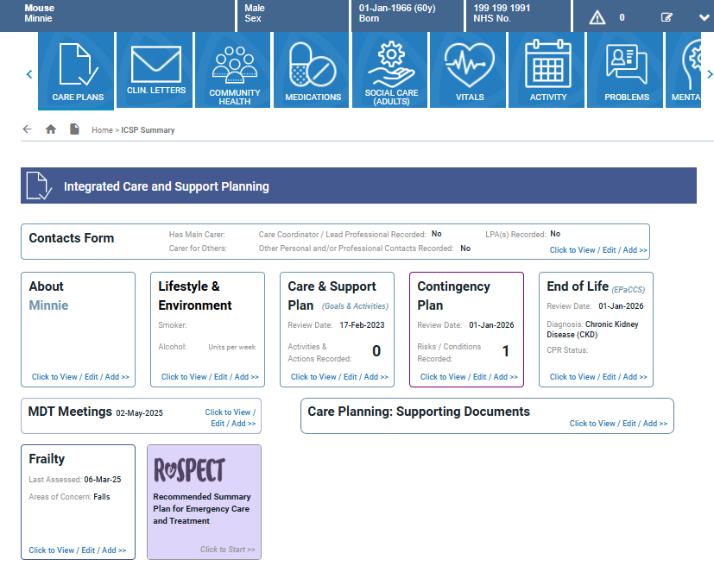
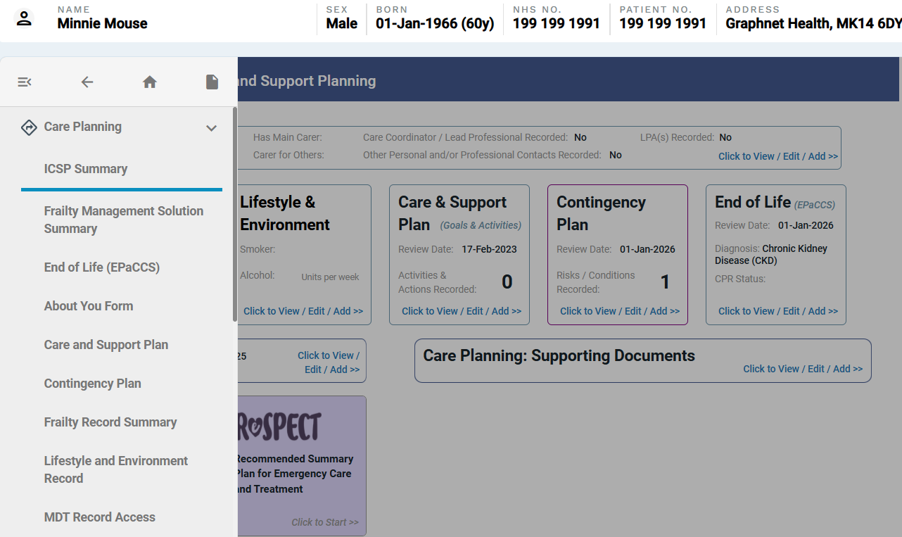
Integrated Care and Support Planning (ICSP)
Old ICR
New Look ICR
No change – The ICSP presents the same

Slide 6
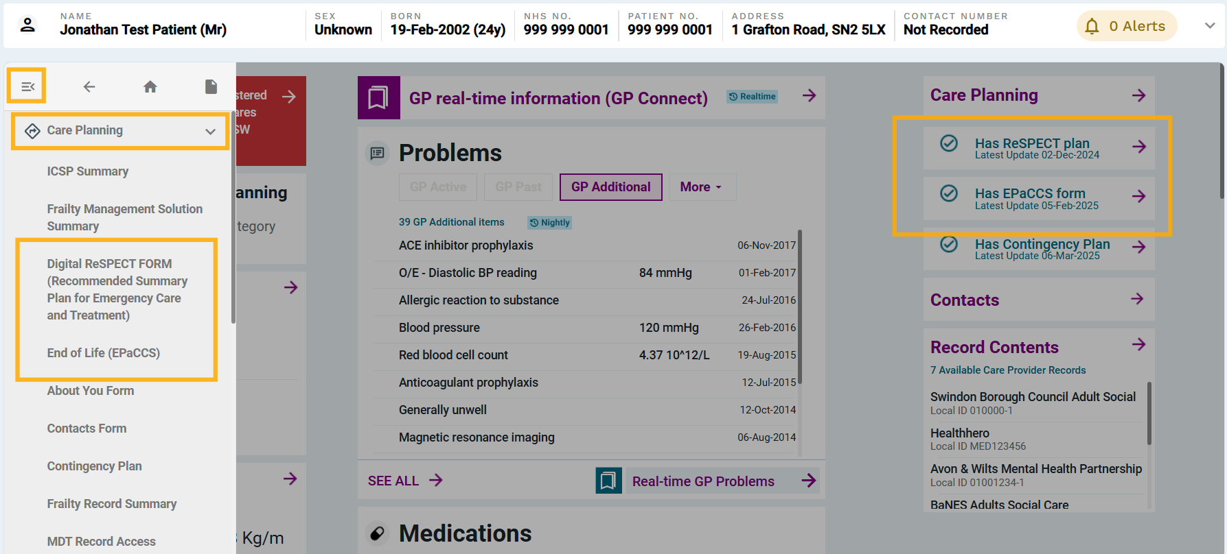
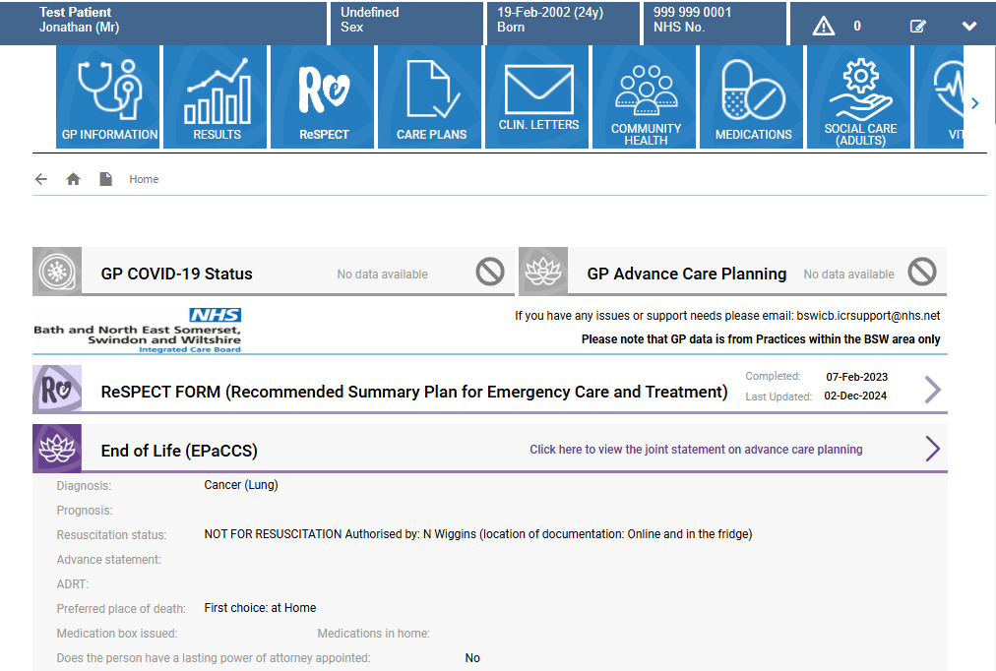
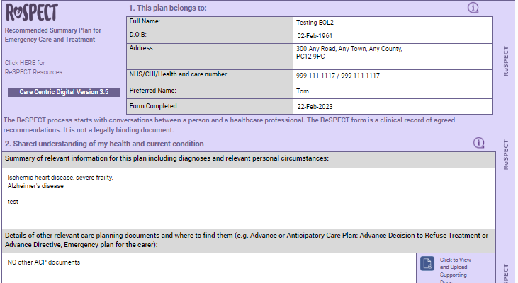
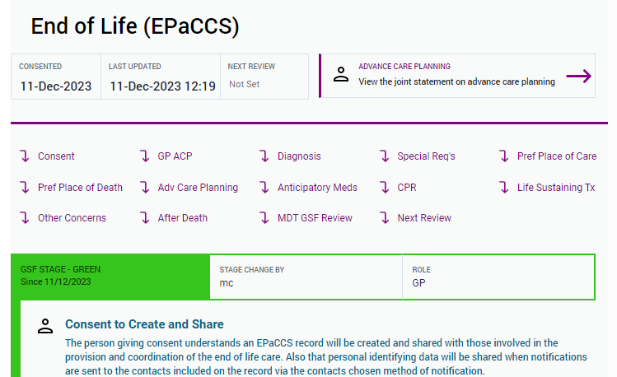
Care Plans- EOL ICR (EPaCCS), Digital ReSPECT
Old ICR
New Look ICR
There will be no changes to the look or functionality of the care plans

Slide 7
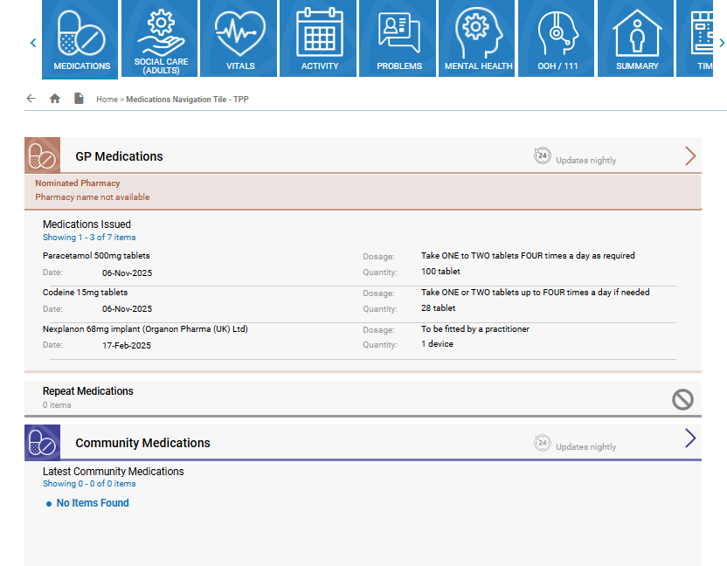
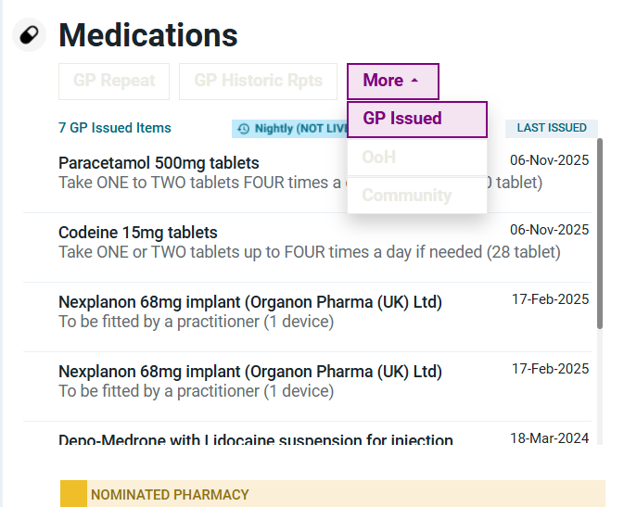
New tabbing system allows accessing of information by feed quicker. You can select the source of information by selecting the relevant tab. If a tab is greyed out this means there is no information available.
New Tiles
Old ICR Medications
New Look ICR Medications

Slide 8
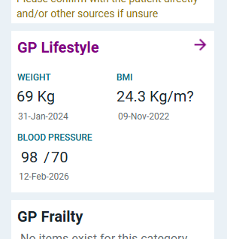
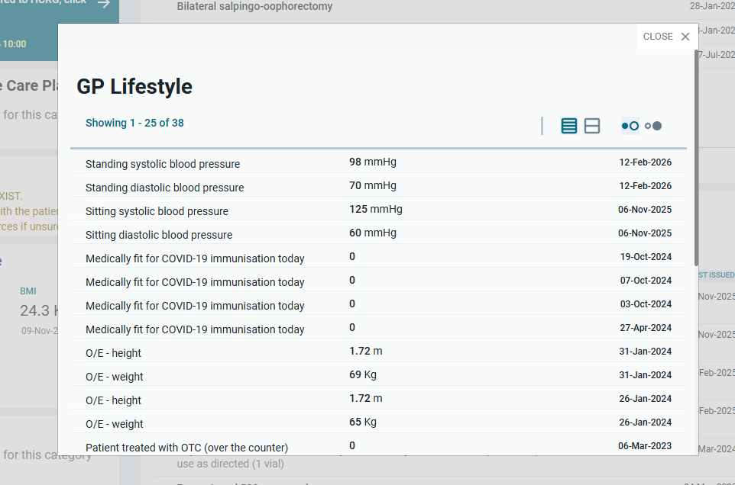
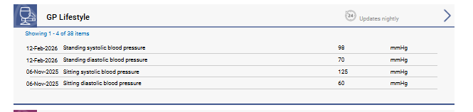
Pop Up windows
Some additional details and historical information can be viewed in pop-up windows, allowing you to stay on the current screen and continue your task without interruption.
Old ICR – clicking on GP lifestyle takes you away from current page
New Look ICR GP Lifestyle pop up window

Slide 9
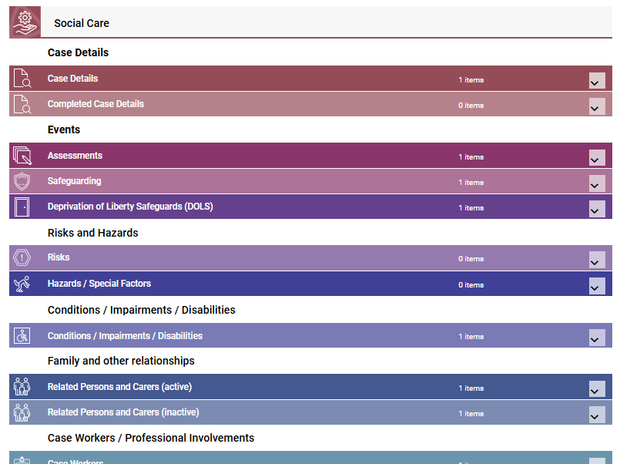
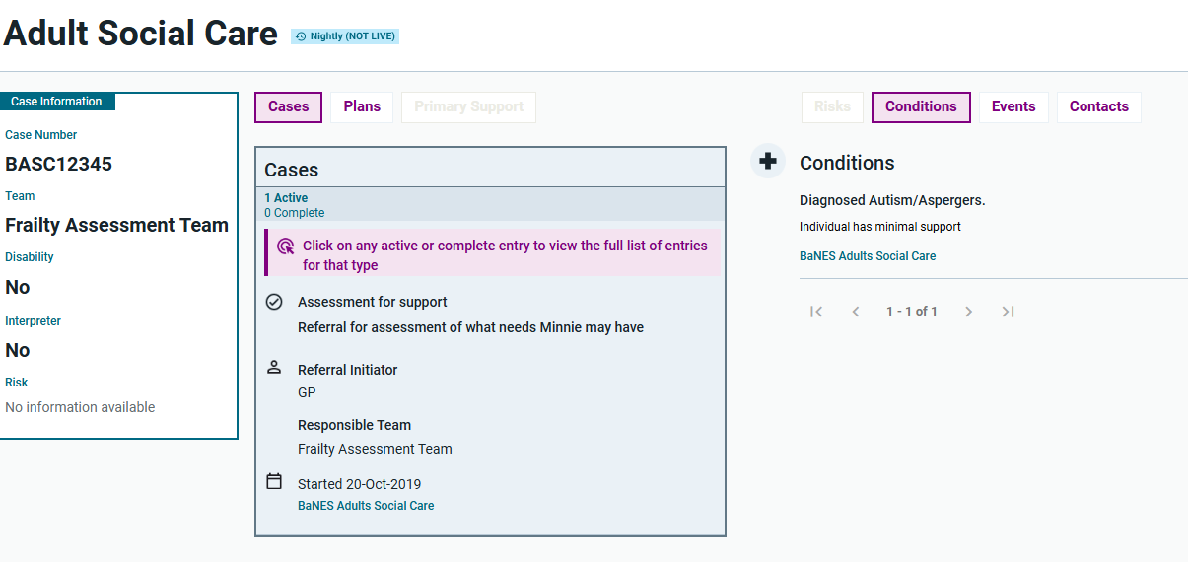
New Summary Views (Social Care example)
The new look ICR organisational summary view displays a variety of data from the shared care record, outlined in a single page. It displays the latest patient information upfront and allows you to navigate different areas that are organised into logical groups.
Old ICR Social Care Summary View
New Look ICR Social Care Summary View

Slide 10
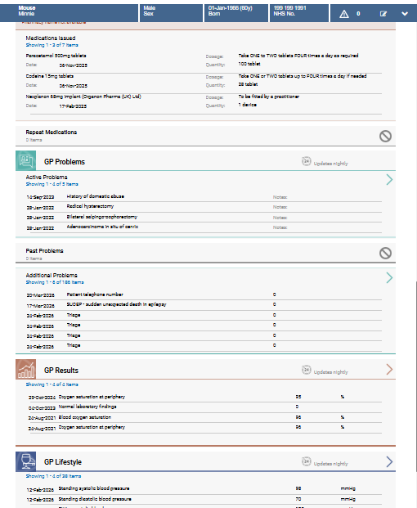
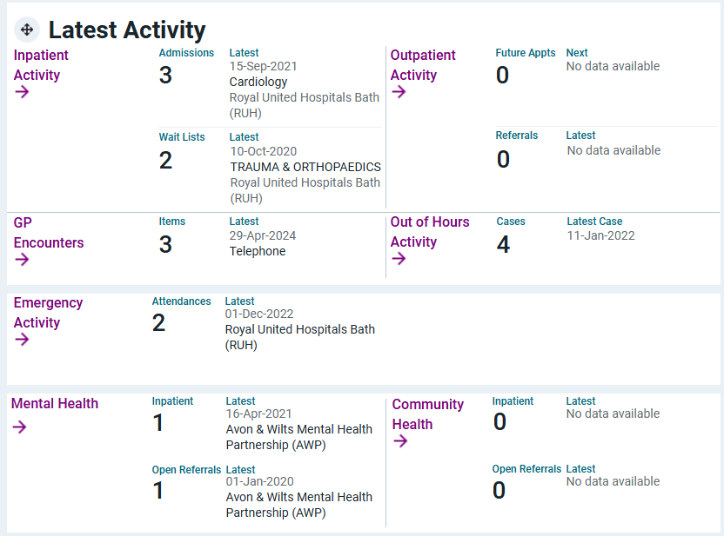
Click on an item to open latest activity
Latest Activity
Old ICR all activity on one page
New ICR Latest Activity

Slide 11
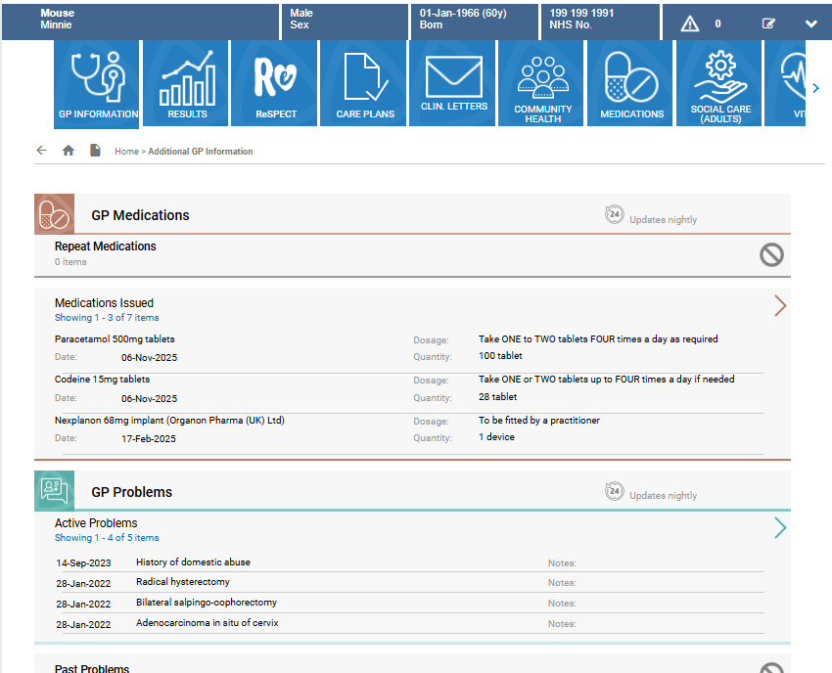
New to ICR: GP Connect
Old ICR – No GP Connect
New Look ICR with GP Connect
You will be able to access GP Connect which is a real-time data feed and will include GP information from non BSW GP Practices. You will be able to view GP information, for out of area patients, including encounters, problems, referrals, medications

Slide 12
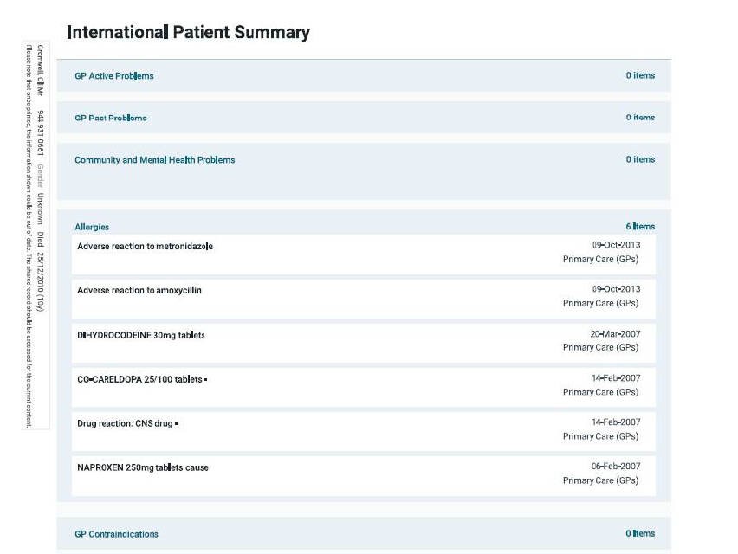
Coming Soon: International Patient Summary
Please note: This functionality will be available in the near future – we will share full guidance on this in due course.
The International Patient Summary (IPS) is a standardised summary of a patient’s key health information from other Shared Care Records.
Authorised users will be able to access the NCRS to view a PDF of the IPS which includes mandatory datasets set by NHSE.
The ICR will soon contain a link to NCRS to view IPS records from other, participating, shared care records.
Some examples of the information that you may see on the International Patient Summary PDF:
GP Problems
Community and Mental Health Problems
Allergies
Planned Activity
Inpatient Activity

