Slide 1


BSW Integrated Care Record
New Look ICR Social Care View

Slide 2
ICR: New Look Changes Benefits
A new Summary Page now displays more useful information upfront to support quicker understanding and decision-making
Improved use of screen space: The new look makes better use of the available screen area, allowing more information to be displayed at once and reducing the need for scrolling.
Consistent data presentation: Information is displayed in a clearer and more consistent way, making it easier to read, scan quickly, and review in detail
Tabbed navigation: Information is grouped into tabs by category, making it easier to find specific details and reducing information overload.
Hero items on Summary Pages: Important information is highlighted at the top of Summary Pages so users can quickly see key details and understand the information that follows.

Slide 3
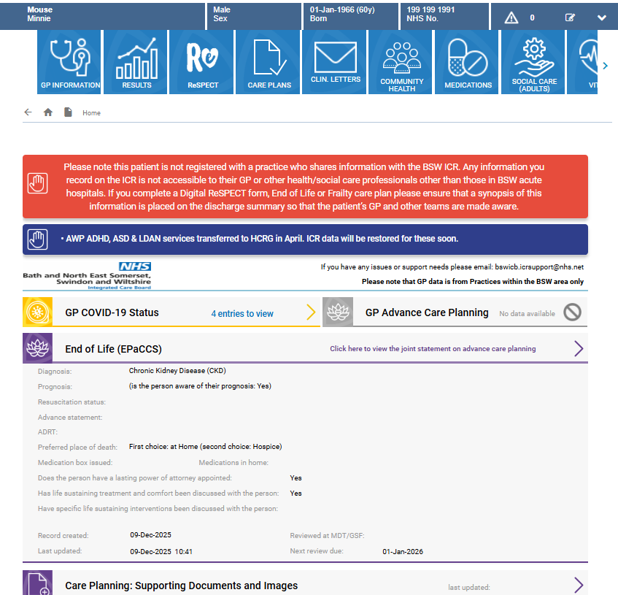
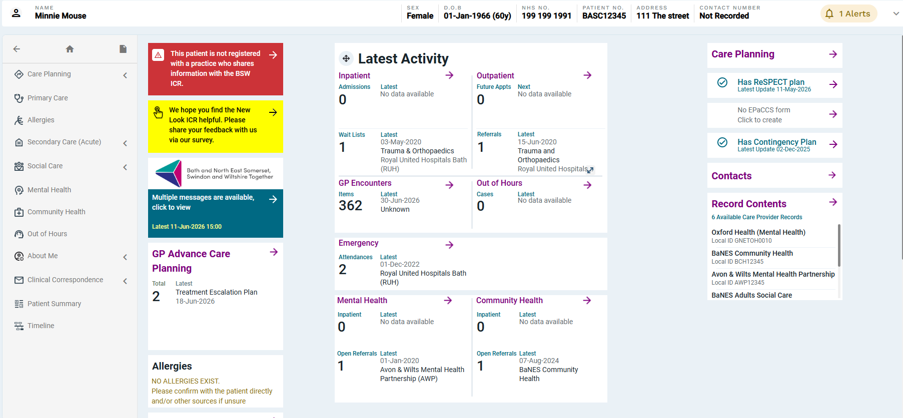
ICR New Look
The New Look ICR features a redesigned summary page and a more user-friendly interface. While the ICR will continue to provide the same valuable patient data, where you find it has changed.
Old ICR Landing Page
New Look ICR Landing Page
The new Summary Page provides key information at a glance, allowing you to quickly find what you need without having to navigate to other sections.

Slide 4
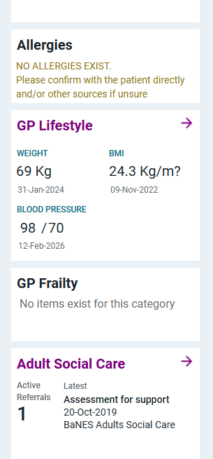
ICR New Look Summary Page
Click on tiles to view further details
Click to view Care Plans
Click to view Clinical Letters (discharge summaries, etc.)
Click to view Patient Summary and Patient Timeline
Scroll down to see further information e.g. Frailty Score

Slide 5
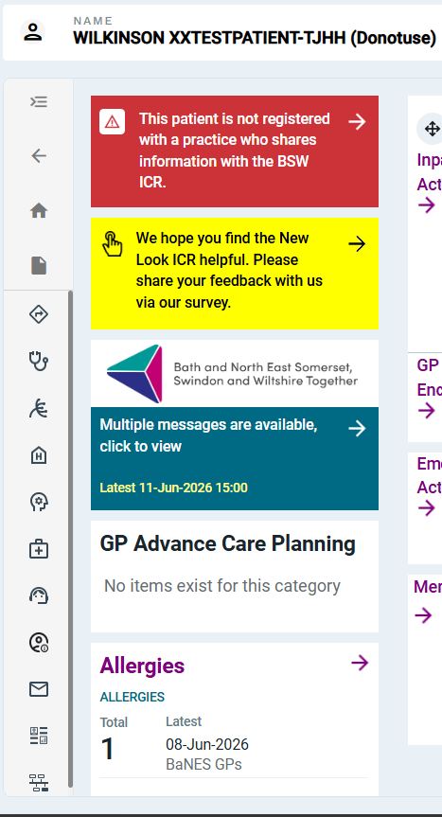
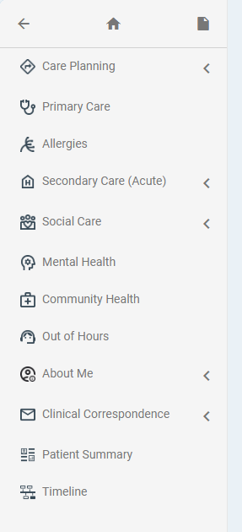
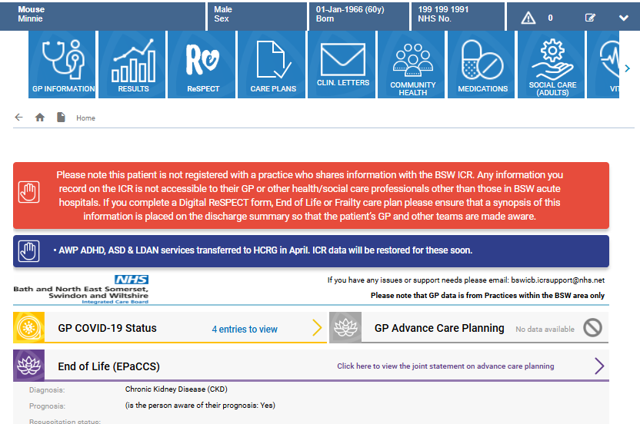
New Look ICR Navigation Menu
Navigation Bar
Old ICR Navigation Tiles
Click to Expand the menu

Slide 6
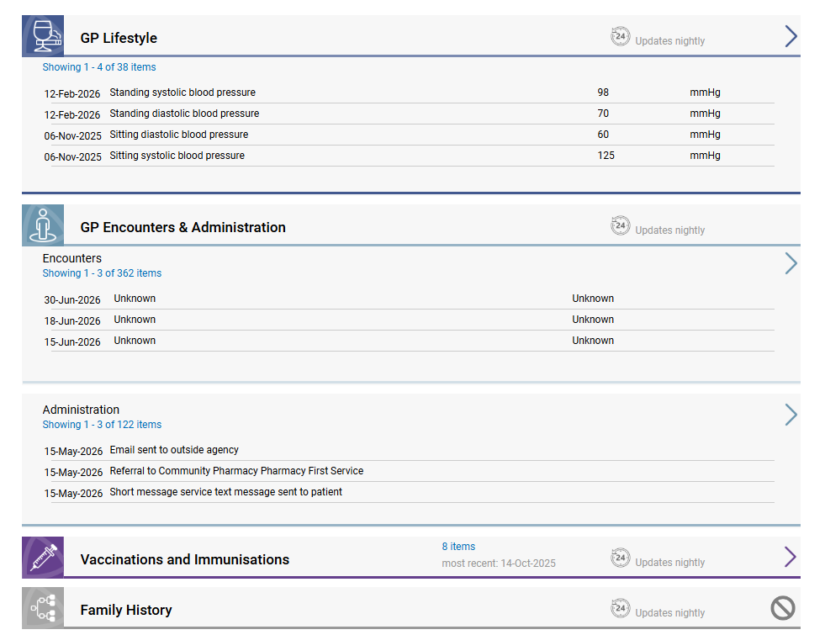
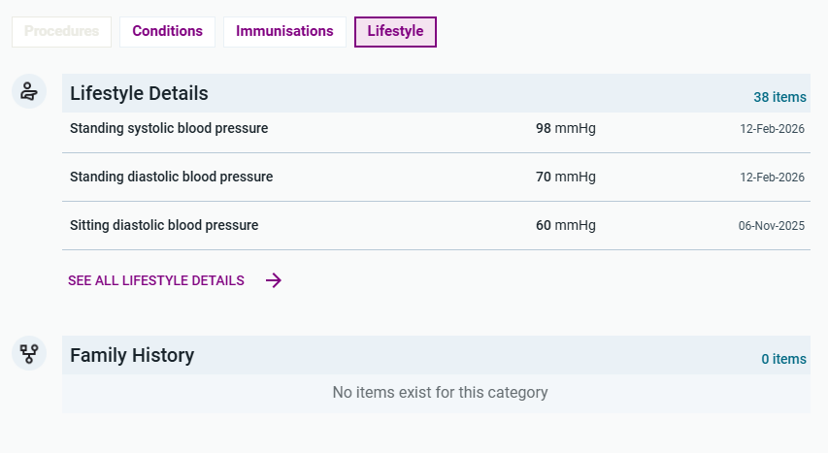
New tabbing system allows accessing of information by feed quicker. You can select the source of information by selecting the relevant tab. If a tab is greyed out this means there is no information available.
New Tiles
Old ICR Medications
New Look ICR Medications

Slide 7
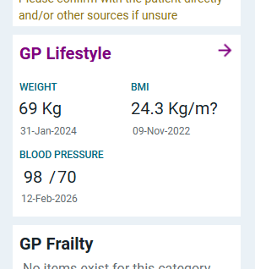
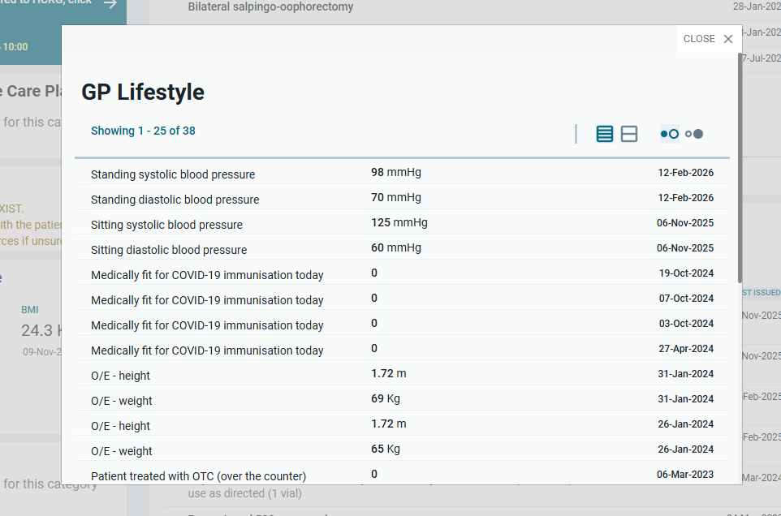
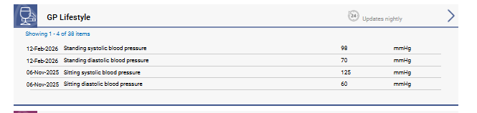
Pop Up windows
Some additional details and historical information can be viewed in pop-up windows, allowing you to stay on the current screen and continue your task without interruption.
Old ICR – clicking on GP lifestyle takes you away from current page
New Look ICR GP Lifestyle pop up window

Slide 8
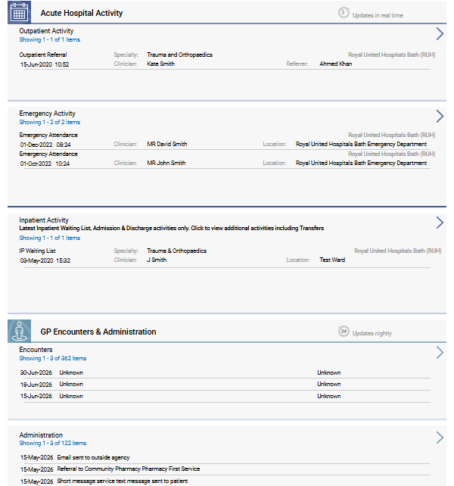
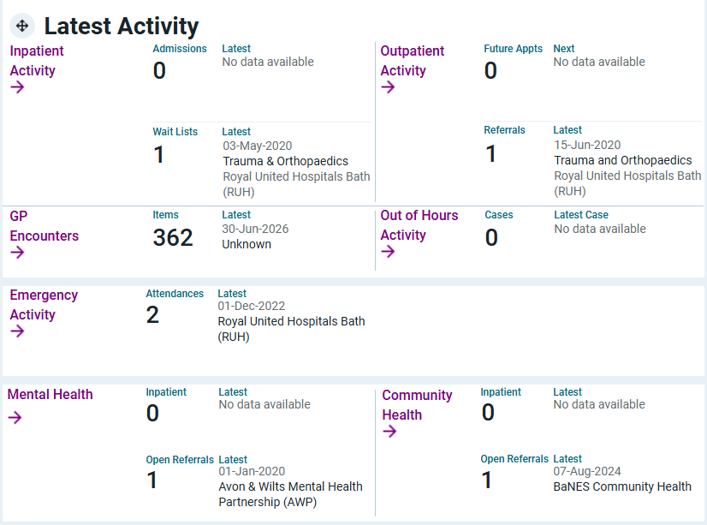
Click on an item to open latest activity
Latest Activity
Old ICR all activity on the Activity Tile
New ICR Latest Activity – on summary page

Slide 9
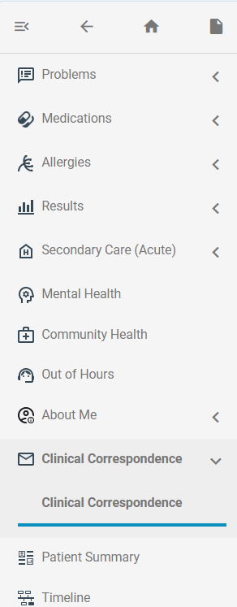
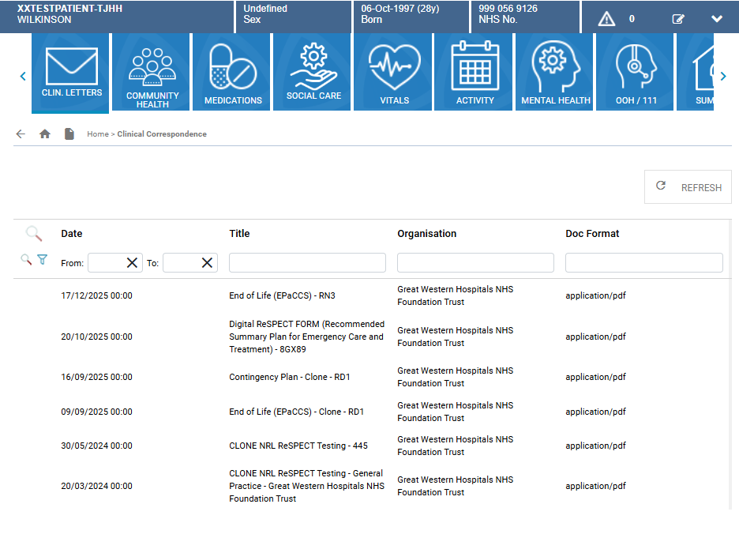
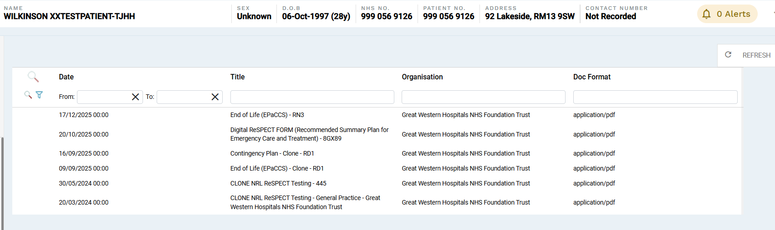
Clinical Letters
New ICR – Clinical Correspondence
Old Clinical Correspondence
There has been no change to Clinical Correspondence – you now access it from the Clinical Correspondence section on the Navigation Menu on the left side of the New Look ICR

Slide 10
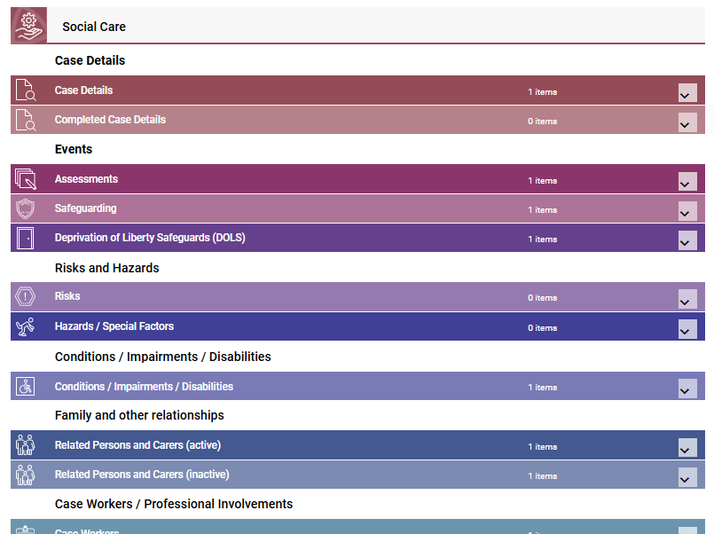
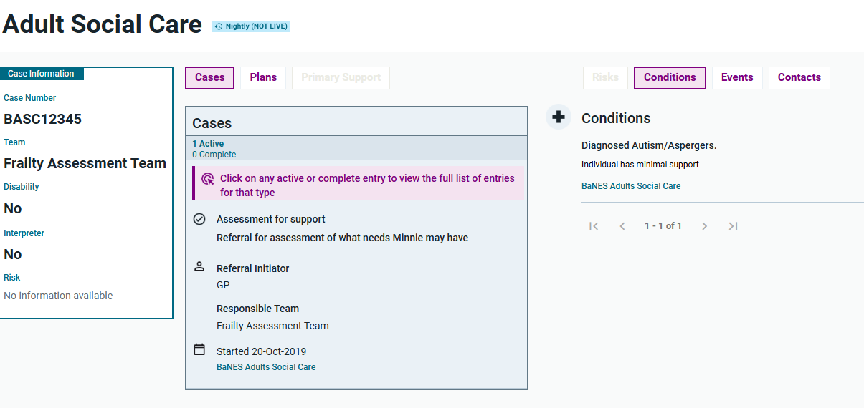
New Summary Views (Social Care example)
The new look ICR organisational summary view displays a variety of data from the shared care record, outlined in a single page. It displays the latest patient information upfront and allows you to navigate different areas that are organised into logical groups.
Old ICR Social Care Summary View
New Look ICR Social Care Summary View

Slide 11
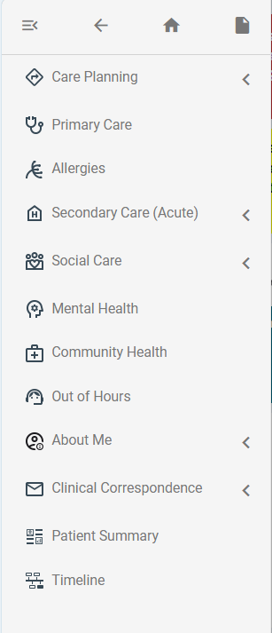
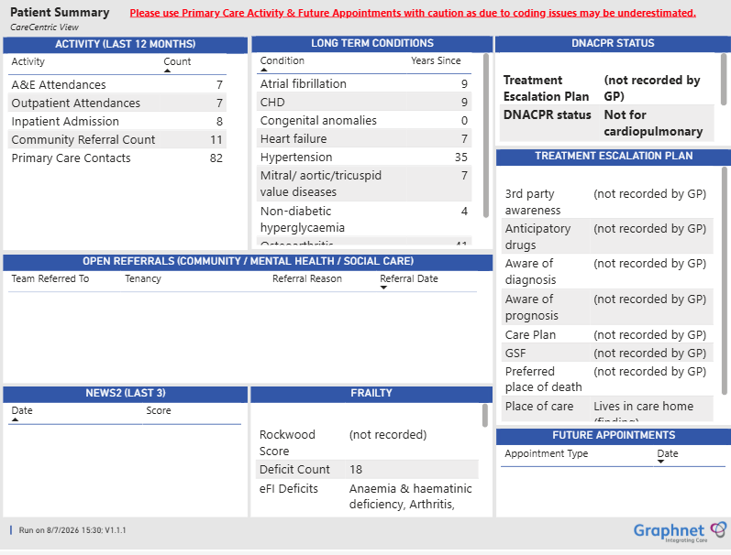
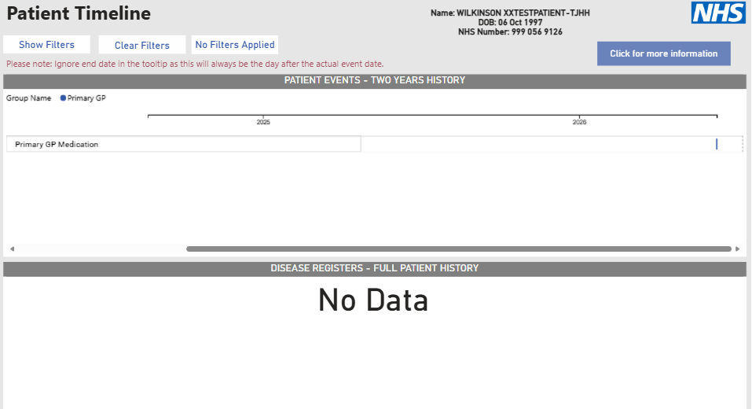
Patient Summary and Timeline
Patient Summary
Patient Timeline
Patient Summary and Timeline are still available to view. Click on the menu bar and click on the section you want to see (you may need to scroll down to see these options)
New ICR Latest Activity – on summary page

Slide 12
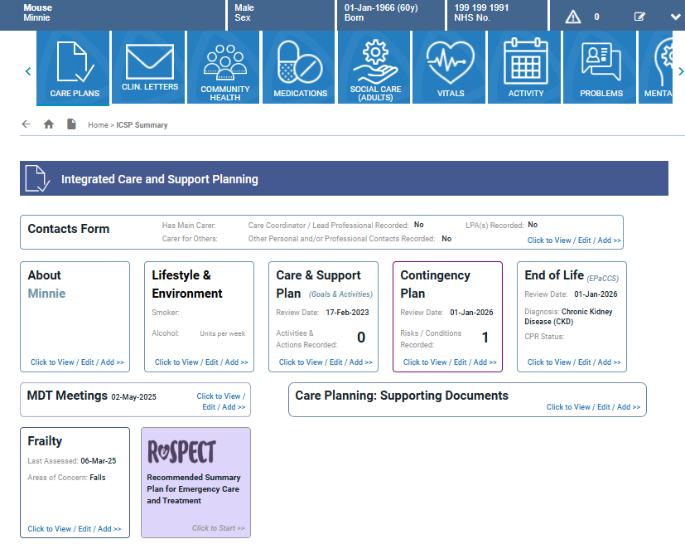
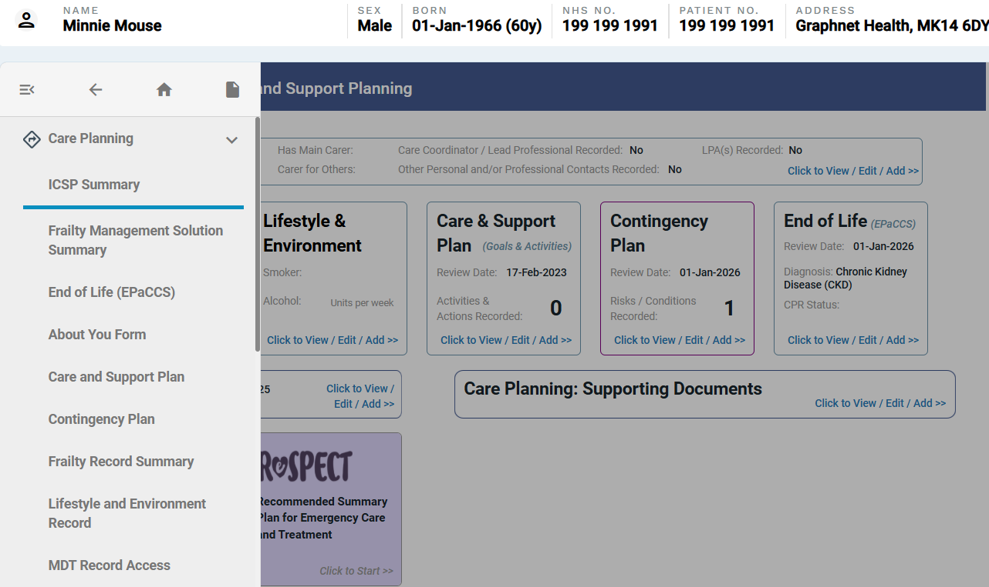
Integrated Care and Support Planning (ICSP)
Old ICR
New Look ICR
No change – The ICSP presents the same

Slide 13
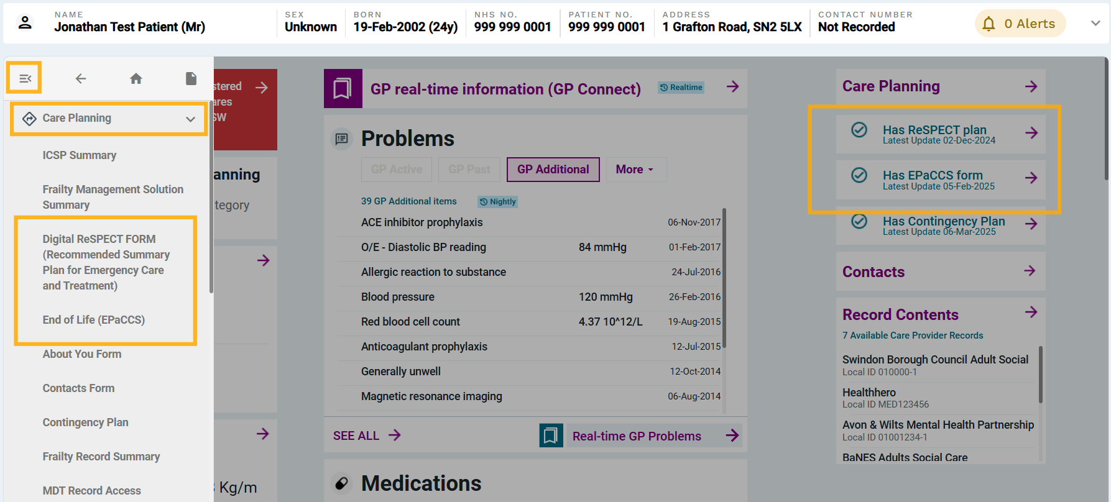
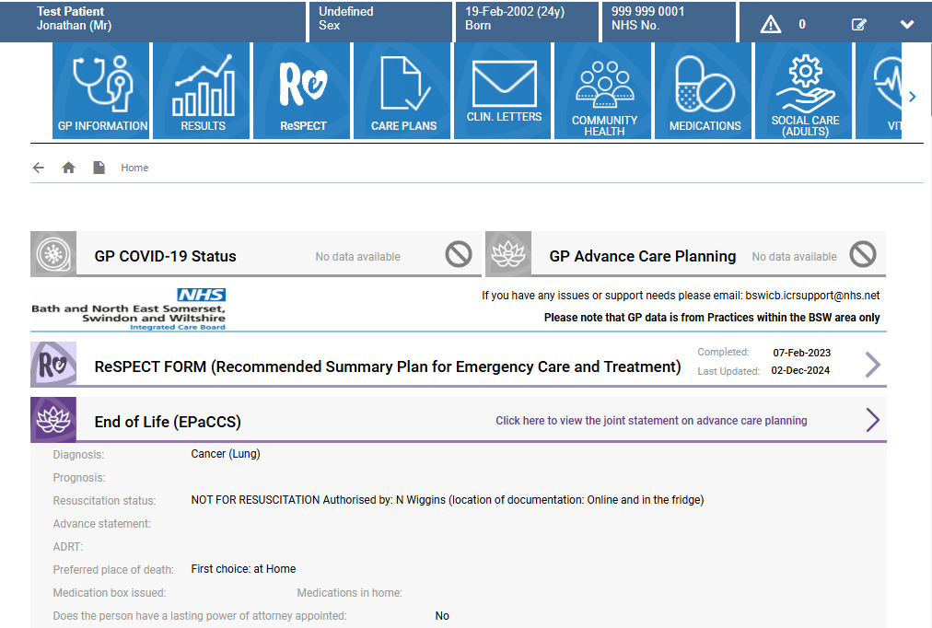
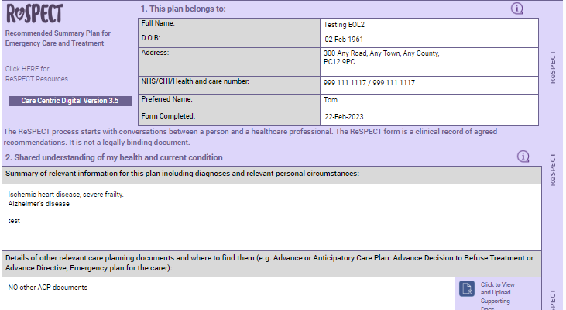
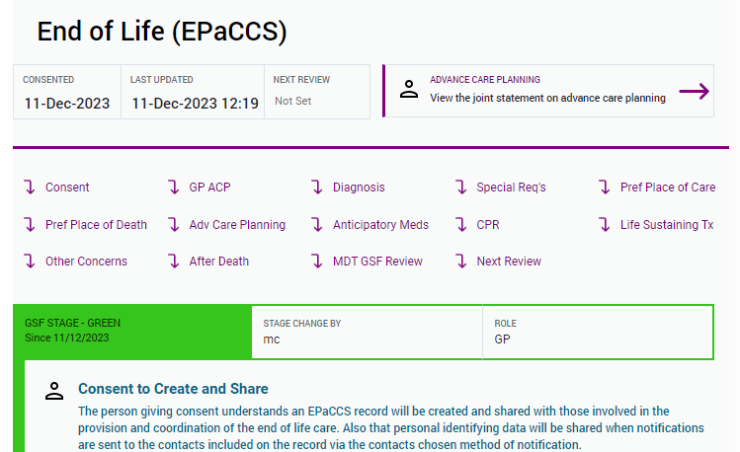
Care Plans- EOL ICR (EPaCCS), Digital ReSPECT
Old ICR
New Look ICR
There will be no changes to the look or functionality of the care plans

